Slide 1
ENPM695 Secure Operating Systems
Jonas Amoonarquah

Slide 2

ThreaT modeling

Slide 3
agenda
Threat Modeling
Attack Surface Analysis

Slide 4
Threat modeling

Slide 5
What is threat modeling?
A method of depicting
System attack surface
Threats
Assets
Can be used in risk management
Estimating probability of attack
Impact of successful attack

Slide 6
Threat Modeling
Structured approach to identifying, quantifying, and addressing threats
Essential part of development process
Just like specing and designing
Just like coding and testing
One technique presented here
There are others (e.g., OCTAVE)
Notes:
The threat modeling technique presented here is widely used within Microsoft

Slide 7
Why do you want to do this?
Surely you have more important things to do?
Primary reason:
Provide software that is secure by design
Attackers think differently
“Creator blindness”
“Forest for the trees”
Threat models provide can provide a whole new perspective on security

Slide 8
When to perform?
Perform early in the development cycle?
Why?

Slide 9
Ways to find security issues
Static Application Security Testing (SAST)
Dynamic Application Security Testing (DAST)
Fuzzing
Post-release bug reports

Slide 10
What’s the best approach?
Think like an attacker?
Focus on the assets?
Focus on what you’re building!

Slide 11
Threat
Capability
Access to the system
Able to reverse engineer binaries
Able to sniff the network
Skill Level
Experienced hacker
Script kiddie
Insiders
Resources and Tools
Simple manual execution
Distributed bot army
Well-funded organization
Access to private information
Threats help
Encourage thorough thought about how intentions for misuse
Determine “out of bounds” scenarios
Notes:
VP #1: A sort of “Rules of Engagement” of WHO you’re interested in.
VP #2: Motivation + Skills and Capabilities tells you what you’re up against and begins to set tone for defenses
VP #3: Level of access explains how much privilege escalation must occur prior to actualization (AKA: How “Mission Impossible” it is)

Slide 12
Identifying Assets
What is it that you want to protect?
Private data (e.g., customer list)
Proprietary data (e.g., intellectual property)
Potentially injurious data (e.g., credit card numbers, decryption keys)
These also count as "assets"
Integrity of back-end databases
Integrity of the Web pages (no defacement)
Integrity of other machines on the network
Availability of the application

Slide 13
Documenting Architecture
Define what the application does and how it's used
Users view pages with catalog items
Users perform searches for catalog items
Users add items to shopping carts
Users check out
Diagram the application
Show subsystems
Show data flow
List assets

Slide 14
How will you defend it?

Slide 15
Attack Trees

Slide 16
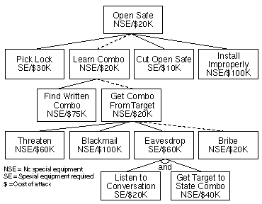
AttacK Tree Theory
Bruce Schneider, Attack Trees: http://www.schneier.com/paper-attacktrees-ddj-ft.html

Slide 17
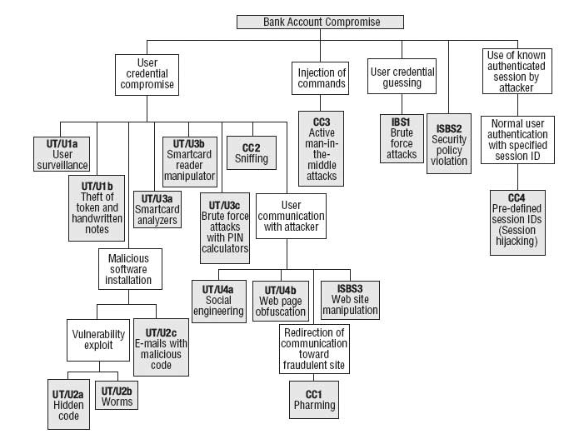
Attack Tree Bank Account Attack Example
Analyzing the Security of Internet Banking Authentication Mechanisms : http://www.itgi.org/Template.cfm?Section=Home&CONTENTID=35743&TEMPLATE=/ContentManagement/ContentDisplay.cfm

Slide 18
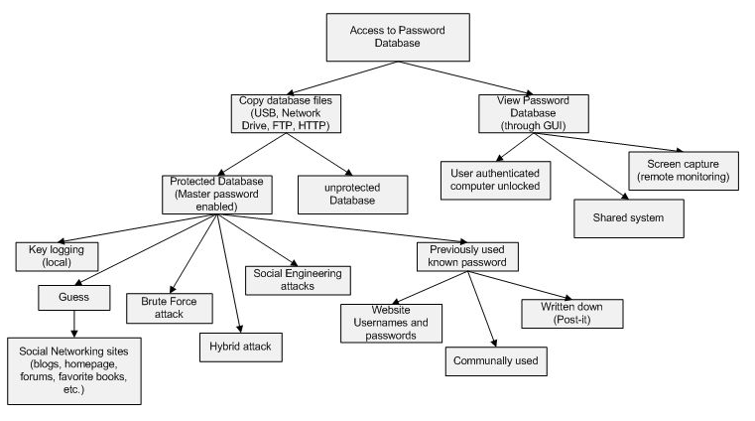
Attack Trees And Attack Analysis: Passwords
Password Management Concerns with IE and Firefox, part one http://www.securityfocus.com/infocus/1882/2

Slide 19
Attack Trees
Theft of
Auth Cookies
Obtain auth cookie to spoof identity
OR
AND
AND
Unencrypted
Connection
Eavesdropping
Cross-Site
Scripting
XSS
Vulnerability
Cookies travel over unencrypted HTTP
Attacker uses sniffer to monitor HTTP traffic
Attacker possesses means and knowledge
Application is vulnerable to XSS attacks
Source: Nagaradhika B., Security Threat Modeling accessed at: http://www.cs.odu.edu/~mukka/cs795sum06/.../Security%20Threat%20Modeling.ppt
Notes:
This is a simple threat tree. In real life, threat trees are numerous and sometimes much more complex

Slide 20
Example
Asset #1
Asset #2
Asset #3
Web Server
Database Server
Firewall
IIS
ASP.NET
Login
Bob
Alice
Main
Bill
State
Asset #4
Asset #5
Asset #6
Source: Nagaradhika B., Security Threat Modeling accessed at: http://www.cs.odu.edu/~mukka/cs795sum06/.../Security%20Threat%20Modeling.ppt
Notes:
Asset #1: public pages (anonymous access allowed)
Asset #2: private pages (viewers require authentication)
Asset #3: Login database (user names and passwords)
Asset #4: Decryption keys
Asset #5: ASP.NET session state database
Asset #6: Main database

Slide 21
Decomposing the Application
Refine the architecture diagram
Show authentication mechanisms
Show authorization mechanisms
Show technologies (e.g., DPAPI)
Diagram trust boundaries
Identify entry points
Begin to think like an attacker
Where are my vulnerabilities?
What am I going to do about them?

Slide 22
Example
Forms Authentication
URL Authorization
Web Server
Database Server
Trust
Firewall
Bob
IIS
ASP.NET
Login
Alice
Main
Bill
State
DPAPI
Windows Authentication
Source: Nagaradhika B., Security Threat Modeling accessed at: http://www.cs.odu.edu/~mukka/cs795sum06/.../Security%20Threat%20Modeling.ppt
Notes:
In this example, forms authentication and URL authorization will be used to authenticate users and define access rules
In this example, the application will use Windows authentication to authenticate against the databases. Windows authentication is one of two forms of authentication supported by SQL Server
In this example, the Windows Data Protection API (DPAPI) will be used to protect the decryption keys.
The trust boundary encompasses both ASP.NET and the database server because the database server trusts ASP.NET to authenticate the caller

Slide 23
Identifying Threats
Method #1: Threat lists
Start with laundry list of possible threats
Identify the threats that apply to your app
Method #2: STRIDE
Categorized list of threat types
Identify threats by type/category
Optionally draw threat trees
Root nodes represent attacker's goals
Trees help identify threat conditions
Notes:
A good way to structure thinking about threat identfication is to think of the big three threat categories: threats against the network, threats against the host, and threats against the application

Slide 24
STRIDE
S
Spoofing
Can an attacker gain access using a false identity?
T
Tampering
Can an attacker modify data as it flows through the application?
R
Repudiation
If an attacker denies doing something, can we prove he did it?
I
Information disclosure
Can an attacker gain access to private or potentially injurious data?
D
Denial of service
Can an attacker crash or reduce the availiability of the system?
E
Elevation of privilege
Can an attacker assume the identity of a privileged user?

Slide 25
Documenting Threats
Theft of Auth Cookies by Eavesdropping on Connection
Threat target | Connections between browsers and Web server
Risk
Attack techniques | Attacker uses sniffer to monitor traffic
Countermeasures | Use SSL/TLS to encrypt traffic
Theft of Auth Cookies via Cross-Site Scripting
Threat target | Vulnerable application code
Risk
Attack techniques | Attacker sends e-mail with malicious link to users
Countermeasures | Validate input; HTML-encode output
Source: Nagaradhika B., Security Threat Modeling accessed at: http://www.cs.odu.edu/~mukka/cs795sum06/.../Security%20Threat%20Modeling.ppt
Notes:
Countermeasures are included here simply for completeness

Slide 26
Rating Threats
Simple model
DREAD model
Greater granularization of threat potential
Rates (prioritizes) each threat on scale of 1-15
Developed and widely used by Microsoft
Risk = Probability * Damage Potential
1-10 Scale
1 = Least probable
10 = Most probable
1-10 Scale
1 = Least damage
10 = Most damage
Source: Nagaradhika B., Security Threat Modeling accessed at: http://www.cs.odu.edu/~mukka/cs795sum06/.../Security%20Threat%20Modeling.ppt
Notes:
Simple model does not directly take into account factors such as whether the attack requires a timing window (e.g., the fact that a stolen authentication cookie is valid for a finite period of time)

Slide 27
DREAD
D
Damage potential
What are the consequences of a successful exploit?
R
Reproducibility
Would an exploit work every time or only under certain circumstances?
E
Exploitability
How skilled must an attacker be to exploit the vulnerability?
A
Affected users
How many users would be affected by a successful exploit?
D
Discoverability
How likely is it that an attacker will know the vulnerability exists?

Slide 28
Example
Threat | D | R | E | A | D | Sum
Auth cookie theft (eavesdropping) | 3 | 2 | 3 | 2 | 3 | 13
Auth cookie theft (XSS) | 3 | 2 | 2 | 2 | 3 | 12
Potential for damage is high
(spoofed identities, etc.)
Cookie can be stolen any time, but is only useful until expired
Anybody can run a packet sniffer; XSS attacks require moderate skill
Prioritized
Risks
All users could be affected, but in reality most won't click malicious links
Easy to discover: just type a <script> block into a field
Source: Nagaradhika B., Security Threat Modeling accessed at: http://www.cs.odu.edu/~mukka/cs795sum06/.../Security%20Threat%20Modeling.ppt
Notes:
Plug these risk ratings back into the threat list and you have a concise list of threats that you can prioritize based on risk

Slide 29
Threat Modeling – High-level process
Diagram structure
Identify assets
Identify Threats
Stitch Threats onto Structure
Enumerate doomsday scenarios
Document misuse/abuse
Enumerate attack vectors
Iterate
Notes:
This slide needs a diagram

Slide 30
Diagram Elements: Examples
External Entity
Data
Flow
Process
Data Store
People
Other systems
Microsoft.com
DLLs
EXEs
COM object
Components
Services
Web Services
Assemblies
Function call
Network traffic
Remote Procedure Call (RPC)
Database
File
Registry
Shared Memory
Queue / Stack
Trust Boundary
Process boundary
File system
Microsoft, “Microsoft SDL Threat Modeling”, https://www.owasp.org/images/9/97/TM.pptx

Slide 31
Diagram layers
Context Diagram
Very high-level; entire component / product / system
Level 1 Diagram
High level; single feature / scenario
Level 2 Diagram
Low level; detailed sub-components of features
Level 3 Diagram
More detailed
Rare to need more layers, except in huge projects or when you’re drawing more trust boundaries

Slide 32
Identify Threats
Experts can brainstorm
How to do this without being an expert?
Use STRIDE to step through the diagram elements
Get specific about threat manifestation
Threat Property we want
Spoofing | Authentication
Tampering | Integrity
Repudiation | Nonrepudiation
Information Disclosure | Confidentiality
Denial of Service | Availability
Elevation of Privilege | Authorization
Notes:
Self explanatory. The next slides go into more detail, with examples

Slide 33
Threat: Spoofing
Threat | Spoofing
Property | Authentication
Definition | Impersonating something or someone else
Example | Pretending to be any of jbezos, cisco.com, or ntdll.dll

Slide 34
Threat: Tampering
Threat | Tampering
Property | Integrity
Definition | Modifying data or code
Example | Modifying a DLL or link library on disk or DVD, or a packet as it traverses the LAN

Slide 35
Threat: Repudiation
Threat | Repudiation
Property | Non-Repudiation
Definition | Claiming to have not performed an action
Example | “I didn’t send that email,” “I didn’t modify that file,” “I certainly didn’t visit that Web site, dear!”

Slide 36
Threat: Information Disclosure
Threat | Information Disclosure
Property | Confidentiality
Definition | Exposing information to someone not authorized to see it
Example | Allowing someone to read the Windows source code; publishing a list of customers to a Web site

Slide 37
Threat: Denial of Service
Threat | Denial of Service
Property | Availability
Definition | Deny or degrade service to users
Example | Crashing a server or desktop or a Web site, sending a packet and absorbing seconds of CPU time, or routing packets into a black hole

Slide 38
Threat: Elevation of Privilege
Threat | Elevation of Privilege (EoP)
Property | Authorization
Definition | Gain capabilities without proper authorization
Example | Allowing a remote Internet user to run commands is the classic example, but going from a “Limited User” to “Admin” is also EoP

Slide 39
Different Threats Affect Each Element Type
ELEMENT
S T R I D E


External Entity






Process

?


Data Store



Data Flow
Notes:
These are the threats which affect each type of element. For example, data flows are subject to tampering, information disclosure and denial of service.
Data stores are subject to tampering, information disclosure and denial of service, and if they’re logs, impact repudiation:
Data stores which are logs come under special attack because they’re logs.
Logs can act as a pass through—lots of security software looks at logs. Be careful about what you write.
If a system has no logs, repudiation is easy.

Slide 40
Standard Mitigations
Spoofing | Authentication | To authenticate principals: Cookie authentication Kerberos authentication PKI systems such as SSL/TLS and certificates To authenticate code or data: Digital signatures
Tampering | Integrity | Windows Mandatory Integrity Controls ACLs Digital signatures
Repudiation | Non Repudiation | Secure logging and auditing Digital Signatures
Information Disclosure | Confidentiality | Encryption ACLS
Denial of Service | Availability | ACLs Filtering Quotas
Elevation of Privilege | Authorization | ACLs Group or role membership Privilege ownership Input validation

Slide 41
The approach in a nutshell
Vision
Diagram
Identify Threats
Mitigate
Validate
Howard, Michael, “Microsoft SDL Threat Modeling”, https://www.owasp.org/images/9/97/TM.pptx

Slide 42
Vision
Scenarios
Where do you expect the product to be used?
XBOX is different from Windows 10
xbox.com is different from XBOX
Use cases/Use Stories/Abuse cases
Add security to scenarios, use cases
Assurances/Guarantees
Structured way to think about “what are you telling customers about the product’s security?”

Slide 43
How to Create Diagrams
Go to the whiteboard
Start with an overview which has:
A few external interactors (some use ‘actors’)
One or two processes
One or two data stores (maybe)
Data flows to connect them
Check your work
Can you tell a story without edits?
Does it match reality?

Slide 44
Diagramming
Use DFDs (Data Flow Diagrams)
Include processes, data stores, data flows
Include trust boundaries
Diagrams per scenario may be helpful
Update diagrams as product changes
Enumerate assumptions, dependencies
Number everything (if manual)

Slide 45
Diagram Elements: Examples
External Entity
Data
Flow
Process
Data Store
People
Browser
Other systems
Cloud
microsoft.com
DLLs
EXEs
COM object
Components
Services
Web Services
Assemblies
Function call
Network traffic
Remote Procedure Call (RPC)
Database
File
Registry
Shared Memory
Queue / Stack
Trust Boundary
Process boundary
File system
Microsoft, “Microsoft SDL Threat Modeling”, https://www.owasp.org/images/9/97/TM.pptx

Slide 46
Diagrams: Trust Boundaries
Add trust boundaries that intersect data flows
Points/surfaces where an attacker can interject
Machine boundaries, privilege boundaries, integrity boundaries are examples of trust boundaries
Threads in a native process are often inside a trust boundary, because they share the same privs, rights, identifiers and access
Processes talking across a network always have a trust boundary

Slide 47
Diagram Iteration
Iterate over processes, data stores, and see where they need to be broken down
How to know it “needs to be broken down?”
More detail is needed to explain security impact of the design
Object crosses a trust boundary
Words like “sometimes” and “also” indicate you have a combination of things that can be broken out
“Sometimes this datastore is used for X”…probably add a second datastore to the diagram

Slide 48
Diagram layers
Context Diagram
Very high-level; entire component / product / system
Level 1 Diagram
High level; single feature / scenario
Level 2 Diagram
Low level; detailed sub-components of features
Level 3 Diagram
More detailed
Rare to need more layers, except in huge projects or when you’re drawing more trust boundaries

Slide 49
A Real Context Diagram (Castle)
Howard, Michael, “Microsoft SDL Threat Modeling”, https://www.owasp.org/images/9/97/TM.pptx

Slide 50
A Real Level-0 DFD (Castle)
Howard, Michael, “Microsoft SDL Threat Modeling”, https://www.owasp.org/images/9/97/TM.pptx

Slide 51
Understanding the threats
Threat | Property | Definition | Example
Spoofing | Authentication | Impersonating something or someone else. | Pretending to be any of billg, xbox.com or a system update
Tampering | Integrity | Modifying data or code | Modifying a game config file on disk, or a packet as it traverses the network
Repudiation | Non-repudiation | Claiming to have not performed an action | “I didn’t cheat!”
Information Disclosure | Confidentiality | Exposing information to someone not authorized to see it | Reading key material from an app
Denial of Service | Availability | Deny or degrade service to users | Crashing the web site, sending a packet and absorbing seconds of CPU time, or routing packets into a black hole
Elevation of Privilege | Authorization | Gain capabilities without proper authorization | Allowing a remote internet user to run commands is the classic example, but running kernel code from lower trust levels is also EoP

Slide 52
Different Threats Affect Each Element Type
ELEMENT
S T R I D E


External Entity






Process

?


Data Store



Data Flow
Notes:
These are the threats which affect each type of element. For example, data flows are subject to tampering, information disclosure and denial of service.
Data stores are subject to tampering, information disclosure and denial of service, and if they’re logs, impact repudiation:
Data stores which are logs come under special attack because they’re logs.
Logs can act as a pass through—lots of security software looks at logs. Be careful about what you write.
If a system has no logs, repudiation is easy.

Slide 53
Apply STRIDE Threats To Each Element
For each thing on the diagram:
Apply relevant parts of STRIDE
External Entity: SR
Process: STRIDE
Data Store, Data Flow: TID
Data stores which are logs: TID+R
Data flow inside a process:
Don’t worry about T,I or D
Number things so you don’t miss them

Slide 54
A Real Level-0 DFD (Castle)
TID
TID
STRIDE
TID
TID
STRIDE
Etc…
Howard, Michael, “Microsoft SDL Threat Modeling”, https://www.owasp.org/images/9/97/TM.pptx

Slide 55
Use the trust boundaries
Trusted/high code reading from untrusted/low
Validate everything for specific uses
High code writing to low
Make sure your errors don’t give away too much

Slide 56
Mitigation is the point of threat modeling
Mitigation:
To address or alleviate a problem
Protect customers
Design secure software
Why bother if you:
Create a great model
Identify lots of threats
Stop
So find problems and fix them
File bugs to track them

Slide 57
Mitigate
Address each threat
Four ways to address threats:
Redesign to eliminate
Apply standard mitigations
Invent new mitigations
Riskier
Accept vulnerability in design
Address each threat!
Notes:
FINDME: If you have support available, mention it here.

Slide 58
Standard Mitigations
Spoofing | Authentication | To authenticate principals: Basic & Digest authentication LiveID authentication Cookie authentication Windows authentication (NTLM) Kerberos authentication PKI systems such as SSL/TLS and certificates IPSec Digitally signed packets To authenticate code or data: Digital signatures Message authentication codes Hashes
Tampering | Integrity | Windows Mandatory Integrity Controls ACLs Digital signatures Message Authentication Codes
Repudiation | Non Repudiation | Strong Authentication Secure logging and auditing Digital Signatures Secure time stamps Trusted third parties
Information Disclosure | Confidentiality | Encryption ACLS
Denial of Service | Availability | ACLs Filtering Quotas Authorization High availability designs
Elevation of Privilege | Authorization | ACLs Group or role membership Privilege ownership Permissions Input validation

Slide 59
Inventing Mitigations is Hard
Mitigations are an area of expertise like networking, databases, or cryptography
Amateurs make mistakes, so do pros
Mitigation failures will appear to work
Until an expert looks at them
We hope that expert will work for us
When you need to invent mitigations, get expert help
We will try to talk you off the ledge ☺

Slide 60
Validating Threat Models
Validate the whole TM
Does diagram match final code?
Are threats enumerated?
Minimum: STRIDE per element that touches a trust boundary
Has Test reviewed the model?
Created appropriate test plans
Tester approach often finds issues with TM, or details
Is each threat mitigated?
Are mitigations done right
Did you check these before Final Security Review?
Shipping will be more predictable

Slide 61
Validate Quality of Threats & Mitigations
Threats
Describe the attack
Describe the context
Describe the impact
Mitigations:
Associate with a threat
Describe the mitigation(s)
File a bug
Fuzzing is a test tactic, not a mitigation

Slide 62
Validate Information Captured
Dependencies
What other code are you using?
What security functions are in that other code?
Are you sure?
Assumptions
Things you note as you build the threat model
“HTTP.sys will protect us against SQL Injection”
“LPC will protect us from malformed messages”
CryptGenRandom will give us crypto-strong randomness

Slide 63
Effective Threat Modeling Meetings
Start with a DFD walkthrough
Identify most interesting elements
Assets (if you identify any)
Entry points/trust boundaries
Walk through STRIDE against those
Threats that cross elements/recur
Consider library, redesigns

Slide 64
Threat Modeling Tool Demo

Slide 65
ExerciseS
Work in teams to:
Identify all diagram elements
Identify threat types to each element
Identify at least 3 threats
Identify first order mitigations
Extra credit: improve the diagram

Slide 66
Exercise #1

Slide 67
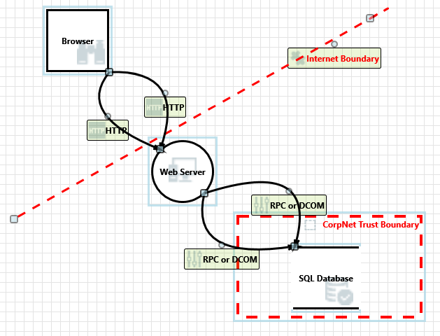
Exercise #1

Slide 68
Exercise #2

Slide 69
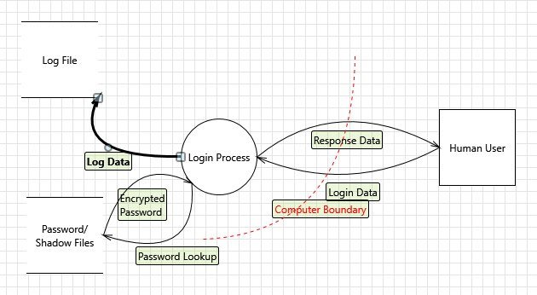
Exercise 2

Slide 70
Attack surface analysis

Slide 71
What is an attack surface
A description of all the different points where
Attacker can get into a system
Data could get out.
According to OWASP, the Attack Surface of an application is:
The sum of all paths for data/commands into and out of the application, and
The code that protects these paths (including resource connection and authentication, authorization, activity logging, data validation and encoding), and
All valuable data used in the application, including secrets and keys, intellectual property, critical business data, personal data and PII, and
The code that protects these data (including encryption and checksums, access auditing, and data integrity and operational security controls).
https://www.owasp.org/index.php/Attack_Surface_Analysis_Cheat_Sheet

Slide 72
What is attack surface analysis
Attack Surface Analysis focuses on
Attack Surface Analysis helps architects to understand the risk areas in a system, what parts of the system are open to attack, and to find ways of minimizing this
Attack Surface Analysis helps:
Identify what functions and what parts of the system require reviewing and/or testing for security vulnerabilities
Identify high risk areas of code that require defense-in-depth protection
Identify when changes have occurred to the attack surface and requires some sort of threat assessment
https://www.owasp.org/index.php/Attack_Surface_Analysis_Cheat_Sheet

Slide 73
How to define the attack surface
Build a baseline
Look at
User interface (UI) forms and fields
HTTP headers and cookies
APIs
Files
Databases
Other local storage
Email or other kinds of messages
Run-time arguments
Others
That’s a lot of entry points
Provide unambiguous description and unique identifier for each entry point
Map roles to entry points
Map resources to entry points
https://www.owasp.org/index.php/Attack_Surface_Analysis_Cheat_Sheet

Slide 74
Making things a bit easier
Break the model up
Function
Design
Technology
Focus on remote entry points
Interfaces with other systems and the Internet
Pay particular attention to
Web forms
Network services
File transfer services
APIs
https://www.owasp.org/index.php/Attack_Surface_Analysis_Cheat_Sheet

Slide 75
Drawbacks
If you’re a real numbers person there’s no easy way to come up with a “number” that says you’re secure
No way to compare different application classes
Web App vs. non-Web App
App vs. OS
Even comparing two different operating systems isn’t really easy
Can compare versions of the same OS though
Relative Attack Surface Quotient
Developed by Michael Howard, Jon Pincus of Microsoft and Jeanette Wing of Carnegie-Mellon

Slide 76
Summary
Without threat modelling, protecting yourself is like “shooting in the dark”
You need expertise in understanding most common attacks – read security bulletins
Developers must learn and use secure coding practices
Learn some crypto too
Assume you are vulnerable, prove you are not
Attack surface analysis is feasible for different systems
More applicable for different versions of the same system
ASA is done in cooperation with threat modeling
Don’t forget about attack trees

Slide 77
Next Week
Cryptography
Homework 2 due by 11:59PM on Wednesday, March 2nd.

Slide 78
rEFERENCES
Nagaradhika B., Security Threat Modeling:
http://www.cs.odu.edu/~mukka/cs795sum06/.../Security%20Threat%20Modeling.ppt
Open Web Application Security Project, ”Attack Surface Analysis Cheat Sheet”, https://www.owasp.org/index.php/Attack_Surface_Analysis_Cheat_Sheet
Howard, Michael, “Microsoft SDL Threat Modeling”, https://www.owasp.org/images/9/97/TM.pptx
Microsoft, “Introduction to Microsoft Security Development Lifecycle (SDL) Threat Modeling”, https://www.microsoft.com/en-us/download/details.aspx?id=16420
Microsoft Threat Modeling Tool:
http://msdn.microsoft.com/security/securecode/threatmodeling/default.aspx
Threat Modeling for Security Tokens in Web Applications:
http://sec.cs.kent.ac.uk/cms2004/Program/CMS2004final/p4a6.pdf

